Slide 1
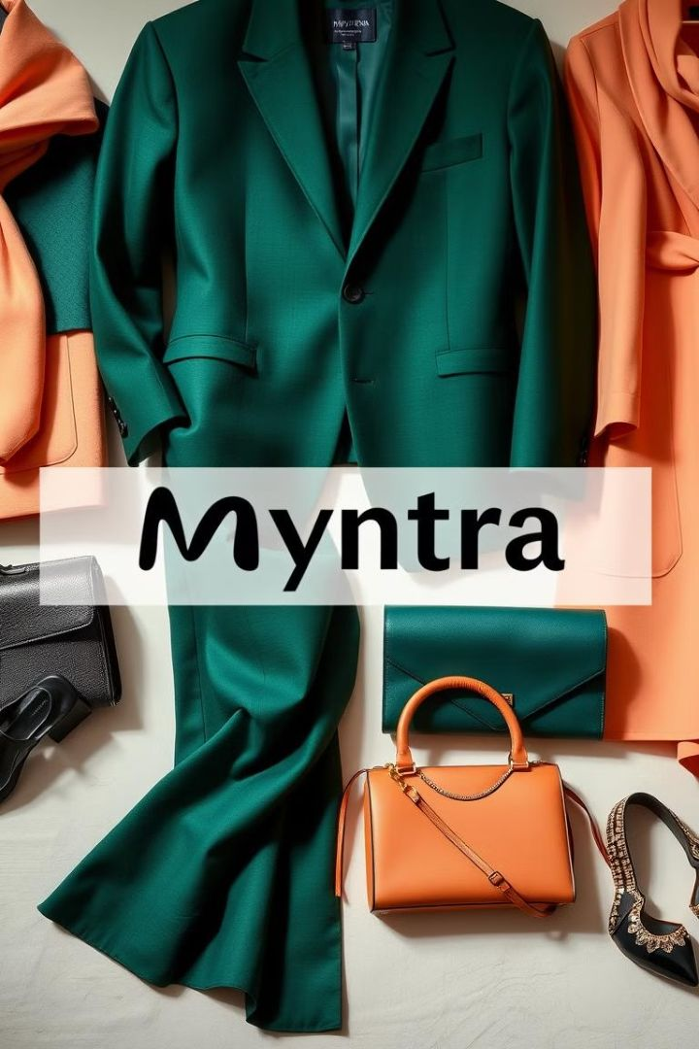

MYNTRA ANALYSIS
Exploring brand perception, customer sentiment, and market trends for Myntra, India's leading online fashion retailer. This analysis provides strategic recommendations based on social media and customer review insights.
GAYATHRI V BADM - MBE11

Slide 2
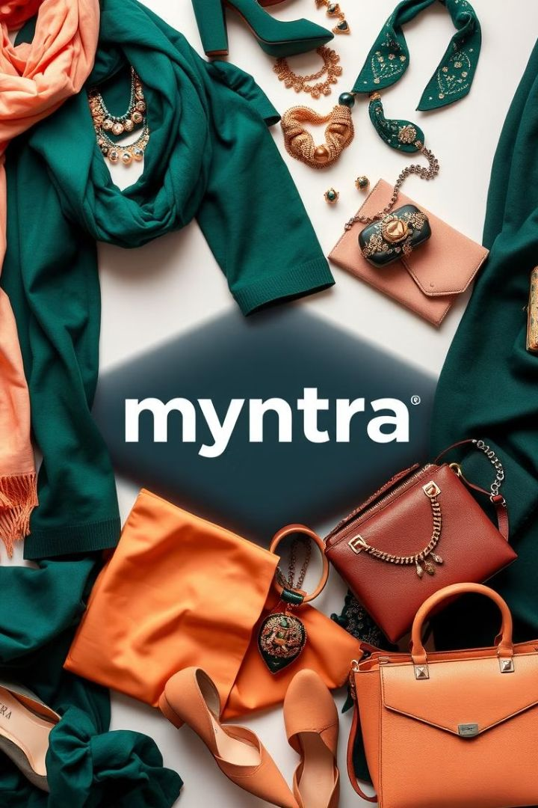
OVERVIEW OF MYNTRA

Slide 3
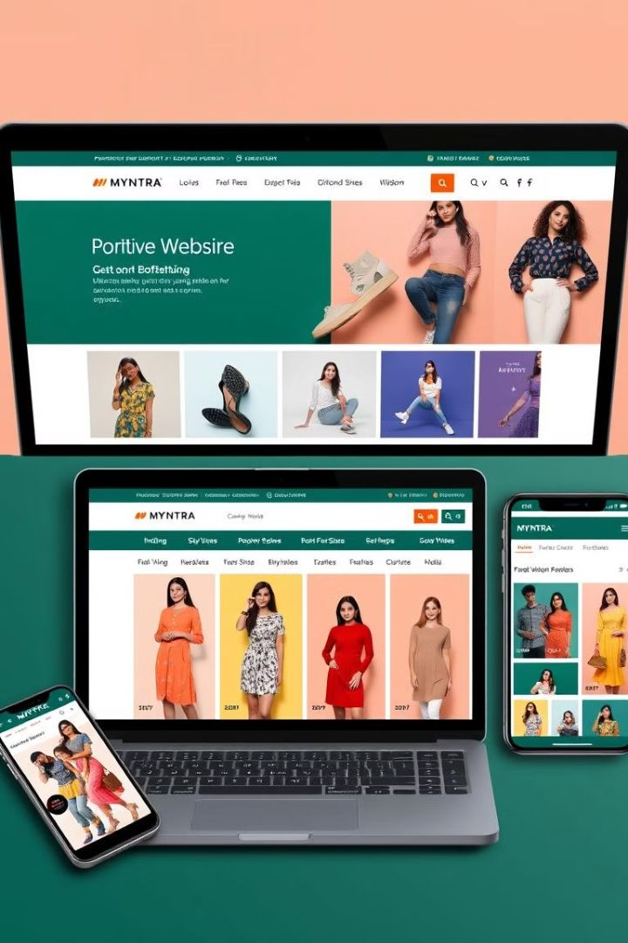
About Myntra
1
2007
Founded as an online platform for personalized products.
2
2014
Acquired by Flipkart, expanding reach and enhancing logistics.
3
Present
One of India's largest online fashion retailers, offering diverse lifestyle products.

Slide 4

Brand Identity
Mission
Democratize access to fashion with high-quality, trendy apparel for India's diverse customers.
Vision
Become India's preferred fashion platform with latest styles and seamless shopping experience.
Values
Customer-centricity, fashion innovation, and accessibility in pricing and trends.

Slide 5
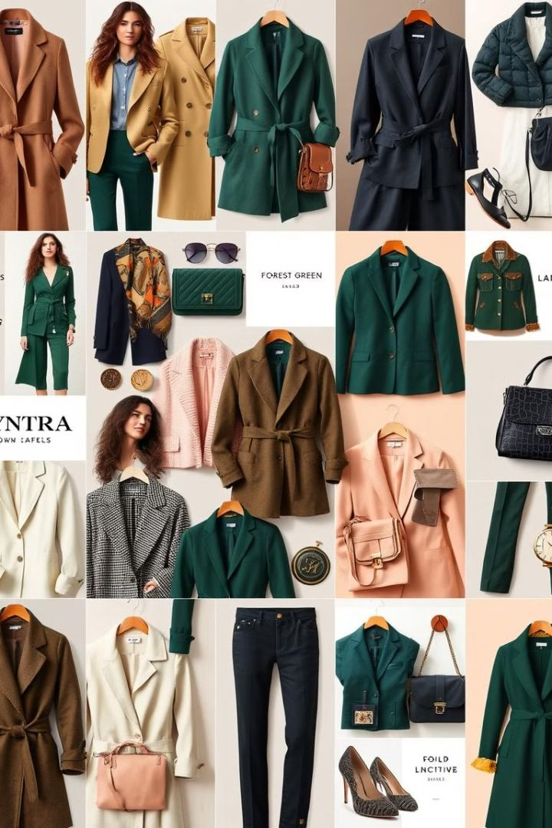



Unique Selling Points
Extensive Catalog
Over 5,000 brands, including exclusive partnerships with international and Indian brands.
Fashion Forward
Strong emphasis on trendy collections and frequent updates.
Seasonal Sales
Known for sales like "End of Reason Sale" with exclusive promotions.

Slide 6
Customer Demographics and Reach
Age Group
Geographical Reach
- Primary Audience: 18–35 years (millennials and Gen Z).
- Secondary Audience: 36–50 years (working professionals and families)
Pan-India presence, delivering to urban and semi-urban areas.
Digital Platforms
Gender
- Website: Primary shopping channel.
- Mobile App: Millions of downloads; highly popular among users.
- Social Media: Active on Instagram, Facebook, Twitter, and YouTube.
Women: 60% Men: 35% Kids: 5% (growing segment).
Income Level
Middle-class and upper-middle-class with disposable income.
Key Metrics
Location
- 50M+ monthly active users.
- Significant sales during End of Reason Sale (EORS) and festive events.
- Strong in Tier 1 cities (e.g., Bengaluru, Mumbai, Delhi).
- Growing in Tier 2/3 cities (e.g., Jaipur, Lucknow).

Slide 7
TASK-I
SOCIAL MEDIA AND REVIEW ANALYSIS

Slide 8
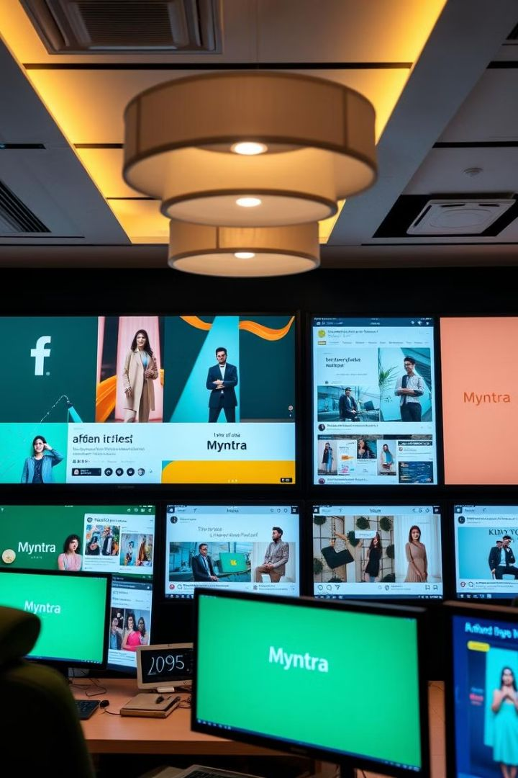
Social Media Analysis Overview
1
Importance
Reflects real-time consumer insights and direct feedback on brand interactions.
2
Platforms
Instagram, Twitter, Facebook, and Google Reviews for diverse feedback.
3
Focus
Monitor trends, gauge public opinion, and identify areas of strength or concern.

Slide 9
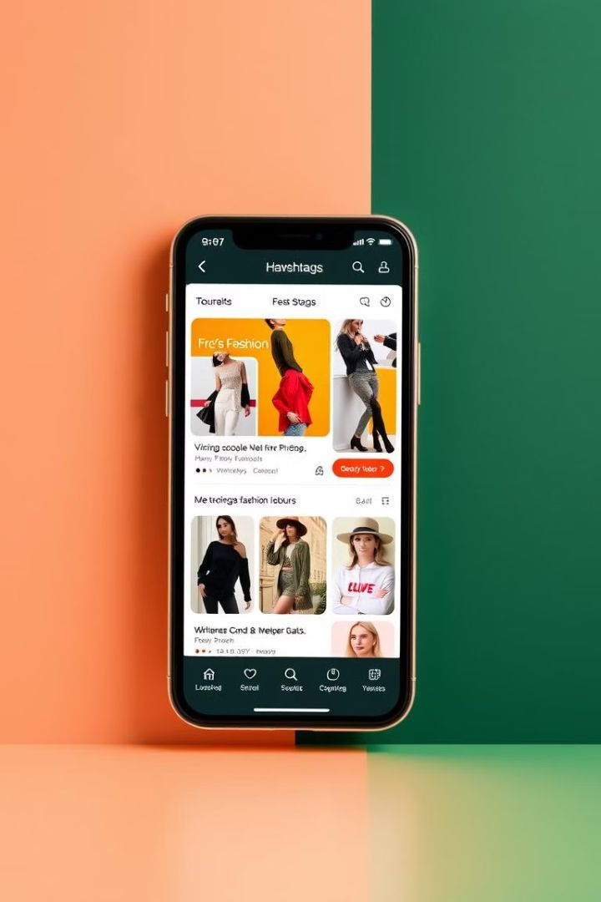
Key Hashtags and Topics
Brand-Specific
#Myntra, #MyntraSale, #MyntraFashion
Fashion-Centric
#fashion, #style, #ethnicwear, #casualwear
Customer Experiences
#onlineshopping, #fashionhaul

Slide 10
TASK-II
DATA COLLECTION

Slide 11
Context of Social Media Posts
Positive Mentions
Negative Mentions
Neutral Mentions
Customers appreciate Myntra's diverse product range and timely delivery services.
Engaging marketing campaigns and collaborations with influencers receive favorable attention.
Complaints about receiving incorrect or damaged products.
Issues with the return and refund process, including delays and unresponsive customer service.
General inquiries about product availability and sizing.
Sharing of personal shopping experiences without explicit positive or negative sentiments.

Slide 12
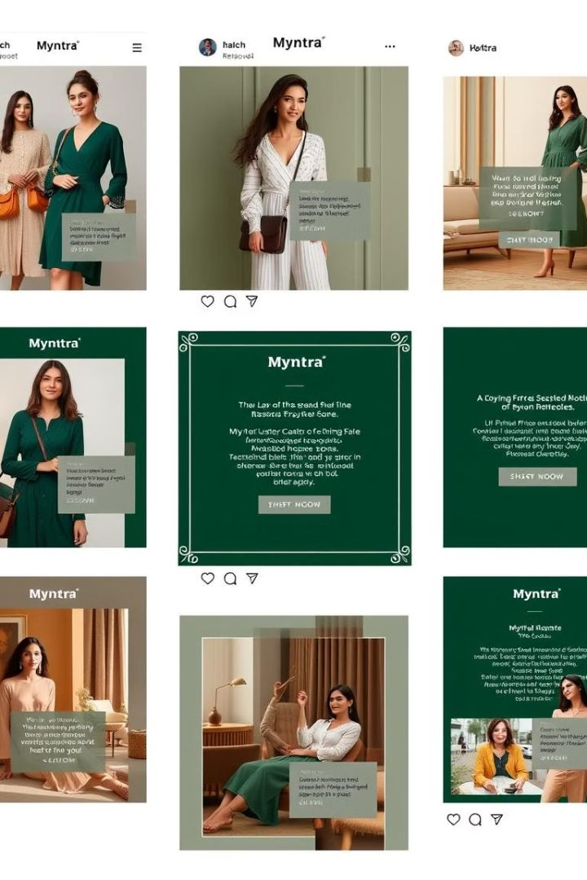



Themes in Social Media Posts
Product Quality
Mixed feedback; while some customers are satisfied, others report issues with product authenticity and quality.
Delivery Service
Generally positive remarks on prompt delivery, though some instances of delays are noted.
Customer Service
Predominantly negative feedback regarding responsiveness and effectiveness in resolving issues.

Slide 13
Customer Review Analysis
MouthShut
Reviews.io
App Store and Google Play Store
Overall rating of 1.9 out of 5 stars, indicating customer dissatisfaction.
Common complaints about receiving wrong products and challenges in the return process.
Reports of poor customer service and issues with product authenticity.
Instances where customers received products without price tags, complicating returns.
Users report a satisfactory shopping experience but express frustration with the app's user interface and filtering options.
Some users faced issues with order cancellations and delayed refunds.

Slide 14
Key Points Extracted
Product Issues
Multiple reports of receiving incorrect or counterfeit items.
Return and Refund Challenges
Difficulties in processing returns and obtaining refunds, with some customers alleging fraudulent practices.
Customer Support Concerns
Perceived unprofessionalism and lack of responsiveness from the customer service team.

Slide 15
TASK-III
BRAND PERCEPTION ANALYSIS

Slide 16
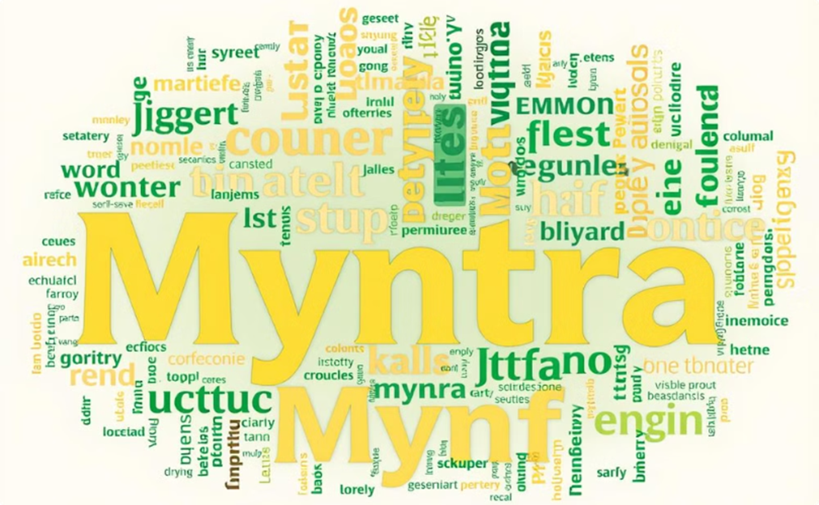
Common Descriptors on Social Media Posts
Positive Descriptors
Stylish: Customers frequently describe Myntra's offerings as trendy and fashionable, appreciating the platform's alignment with current fashion trends.
Convenient: Users commend the user-friendly interface and seamless shopping experience.
Negative Descriptors
Poor Customer Service: Numerous posts highlight dissatisfaction with customer support, citing unresponsiveness and inadequate issue resolution.
Delivery Issues: Complaints about delayed deliveries and receiving incorrect or damaged products are common.

Slide 17

Brand perception Insight
Myntra is perceived as a stylish and convenient platform offering a wide range of fashionable products. However, significant concerns exist regarding customer service quality and delivery reliability. Addressing these issues is crucial for enhancing overall customer satisfaction and brand perception.
Platforms Analyzed: Twitter, Instagram, Facebook

Slide 18
TASK-IV
CUSTOMER SENTIMENT ANALYSIS

Slide 19
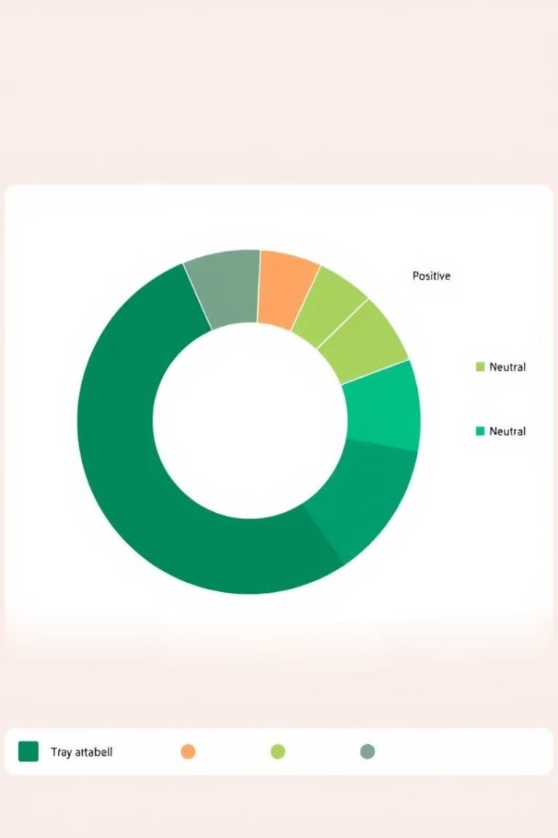
Sentiment Categorization
1
Positive Sentiment (65%)
Driven by quality products, trendy options, and user-friendly app experience.
2
Neutral Sentiment (20%)
Average experiences that meet but don't exceed expectations.
3
Negative Sentiment (15%)
Issues with customer service, delivery delays, and product inconsistencies.
Strategic Implications
Focus on improving service and post-purchase engagement to boost satisfaction.

Slide 20
TASK-V
MARKET TRENDS IDENTIFICATION

Slide 21
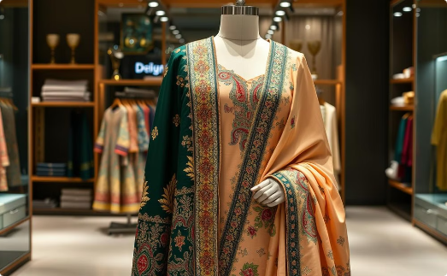
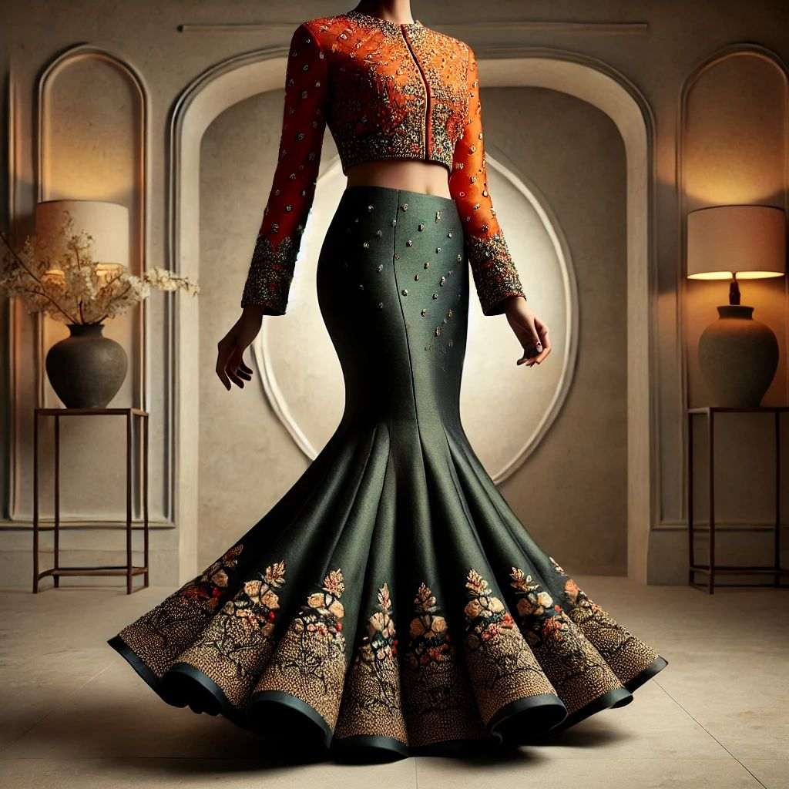
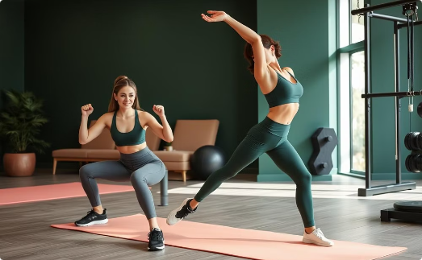
Popular Styles and Categories
Source : Hatkay & G3 Fashion
Pakistani Salwar Influence
Mermaid Skirts
Sportswear and Athleisure
The Pakistani salwar style is making a significant impact, with its elegant and comfortable design appealing to many.
The mermaid skirt silhouette is emerging as a trend in Indian fashion, offering a modern style in lehenga designs.
Sportswear is a general term for casual clothing that's typically worn for spectator sports, while athleisure is a style of clothing that combines sportswear with casual wear

Slide 22
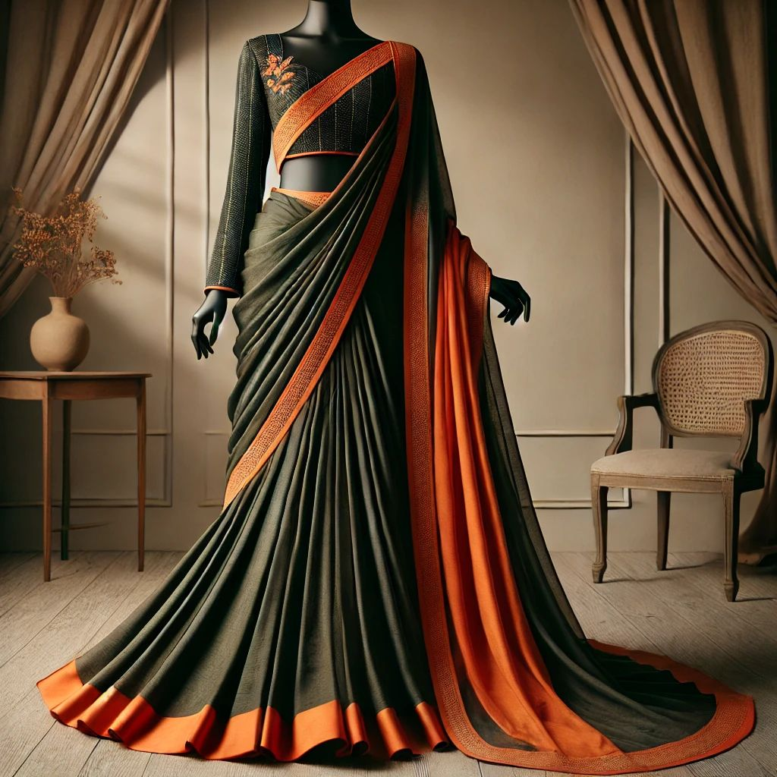
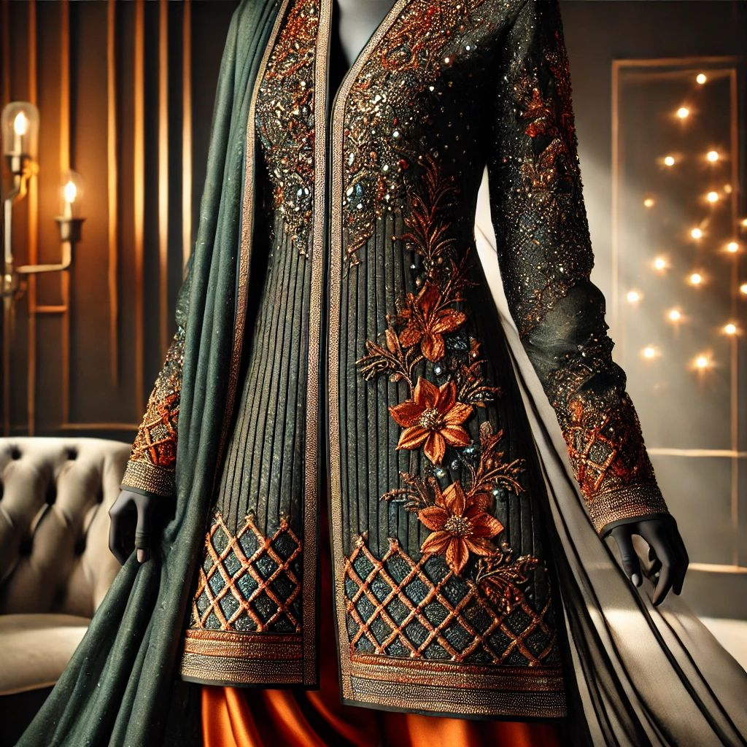
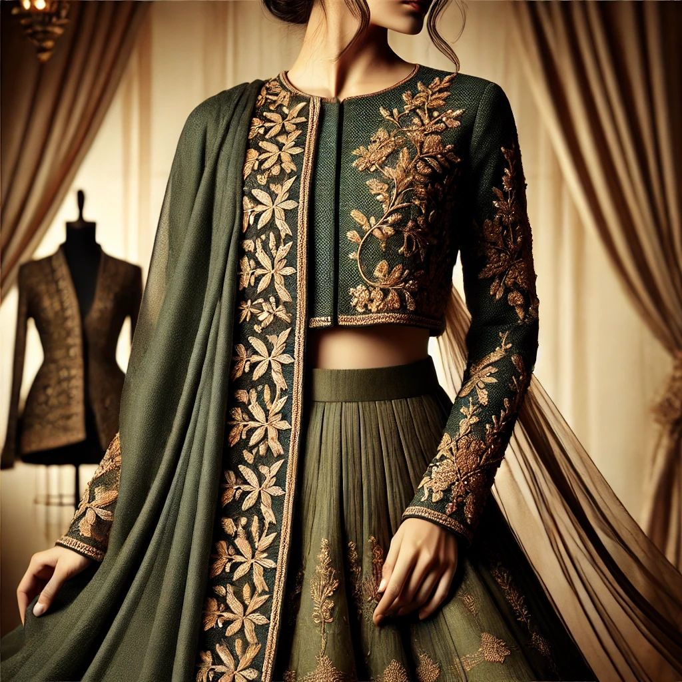
Popular Styles and Categories
Fusion Wear
Metallic Accents
Ethnic Jackets and Long Shrugs
The blend of traditional Indian attire with Western elements is gaining popularity. Saree gowns and lehenga skirts paired with contemporary tops exemplify this trend, offering a unique look that merges tradition with modernity.
Incorporating metallic fabrics and embellishments into traditional outfits is on the rise, adding a modern twist to classic designs.
Layering traditional outfits with ethnic jackets and long shrugs is becoming a favored style, providing versatility and a contemporary edge.

Slide 23
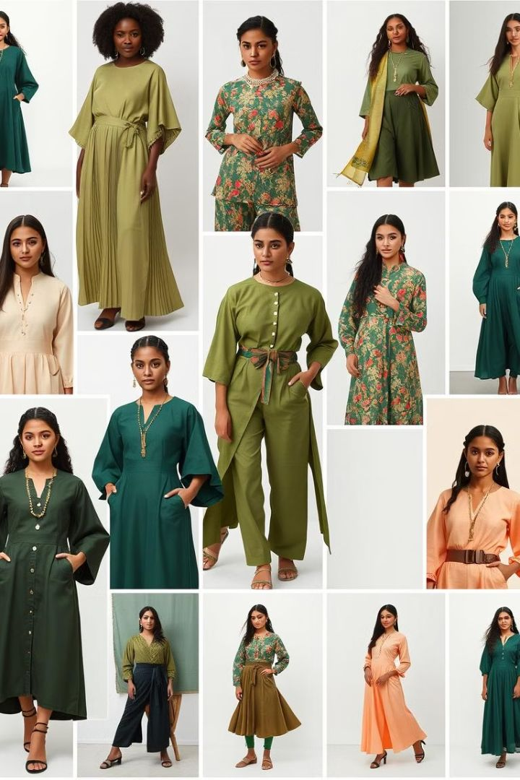



Key Influencer Initiatives
Myntra Fashion Superstar
A reality show hosted on the Myntra app, aiming to discover and promote
emerging fashion influencers. Participants showcase their styling skills,
with winners gaining significant exposure and opportunities to collaborate
with Myntra. Instagram
Myntra Studio
An in-app content platform where influencers curate looks, share fashion tips,
and engage with users. This initiative allows influencers to directly impact
purchasing decisions by linking featured products. . Myntra
Maya – Virtual Influencer
Myntra introduced 'Maya,' its first virtual fashion influencer, to engage with the
digital-native audience. Maya interacts with users, showcases styles, and
represents Myntra in the virtual fashion space. India Today

Slide 24
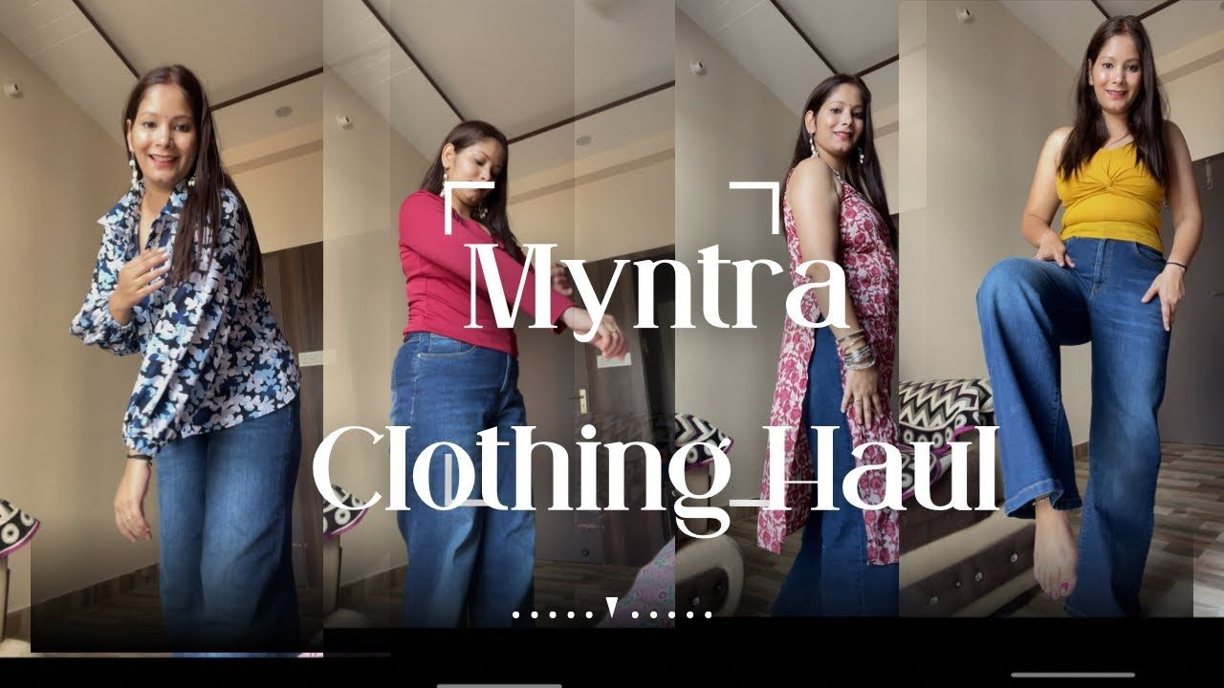
Notable Influencers Associated with Myntra
Asmita Kaushik
A fashion and travel influencer who was among the top contestants in Myntra Fashion Superstar Season 2. She shares her outfits and styling tips, influencing her followers' fashion choices. INSTAGRAM
Myntra Style Squad Members
Influencers like Sonali Malhotra, Gaurav Pandey, and Arti Chauhan
are part of Myntra's Style Squad, creating content that resonates
with fashion enthusiasts and drives engagement on the platform.
MYNTRA BLOG

Slide 25
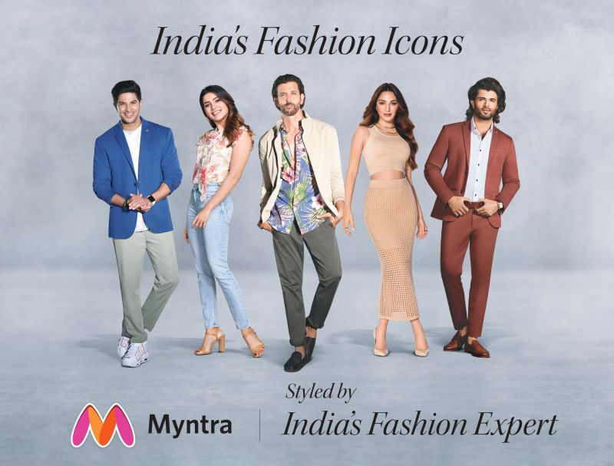
Influencer-Driven Campaigns
Myntra FWD
Targeting Gen Z shoppers, this campaign collaborated with over 15,000 influencers across various tiers, garnering more than 60 million views. The initiative leveraged influencers' credibility to promote fashion, beauty, and lifestyle products, significantly enhancing brand visibility among younger audiences.
SOCIAL SAMOSA

Slide 26
TASK-VI
COMPETITIVE LANDSCAPE ASSESSMENT

Slide 27
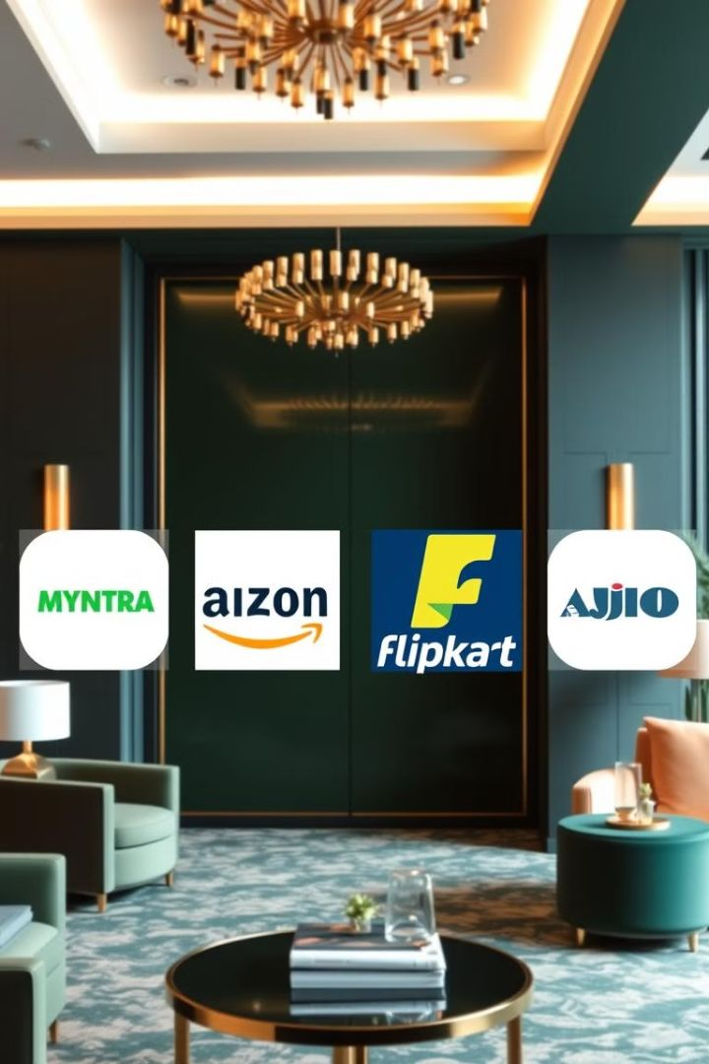
Competitor Landscape
Competitor
Strength
Amazon Fashion
Vast reach, aggressive pricing
Flipkart Fashion
Competitive pricing, diverse offerings
AJIO
Trend-focused, unique brand identity

Slide 28

Amazon Fashion
Strengths
Weaknesses
Extensive Product Range
Limited Focus on Fashion
Amazon Fashion offers a vast selection of products, catering to diverse customer preferences.
As a general e-commerce platform, Amazon's fashion segment may lack the specialized curation found in fashion-focused platforms
Efficient Logistics
Inconsistent Quality Control
Amazon's robust supply chain ensures timely deliveries and a seamless customer experience
The extensive range of third-party sellers can lead to variability in product quality and customer satisfaction
Customer Trust
Amazon's global presence and reputation contribute to high customer confidence and loyalty

Slide 29

Flipkart
Strengths
Weaknesses
Strong Market Presence
Intense Competition
Flipkart is one of India's largest e-commerce platforms, offering a wide array of products.
Facing competition from Amazon, AJIO, and others, Flipkart's market share growth is challenged
Effective Marketing Strategies
Innovative campaigns and large-scale sales events, such as the "Big Billion Days," drive significant customer engagement.
Operational Challenges
Managing a vast product portfolio and supply chain can lead to high operational costs and complexities
Localized Approach
Flipkart's understanding of the Indian market enables tailored offerings that resonate with local consumers

Slide 30
AJIO
Strengths
Weaknesses
Unique Product Offerings
Intense Market Competition
AJIO emphasizes private labels and a blend of Western and traditional Indian attire, catering to diverse consumer preferences
AJIO faces challenges from established players like Myntra and Flipkart, requiring continuous innovation to maintain market share
Curated Collections
Inventory Management
The platform offers a mix of high-fashion designer wear, affordable international brands, and local designer collections, providing a unique shopping experience
Ensuring consistent product availability across categories can be challenging, potentially affecting customer satisfaction
Strong Brand Backing
Supported by Reliance Industries, AJIO benefits from a strong brand image and extensive resources

Slide 31
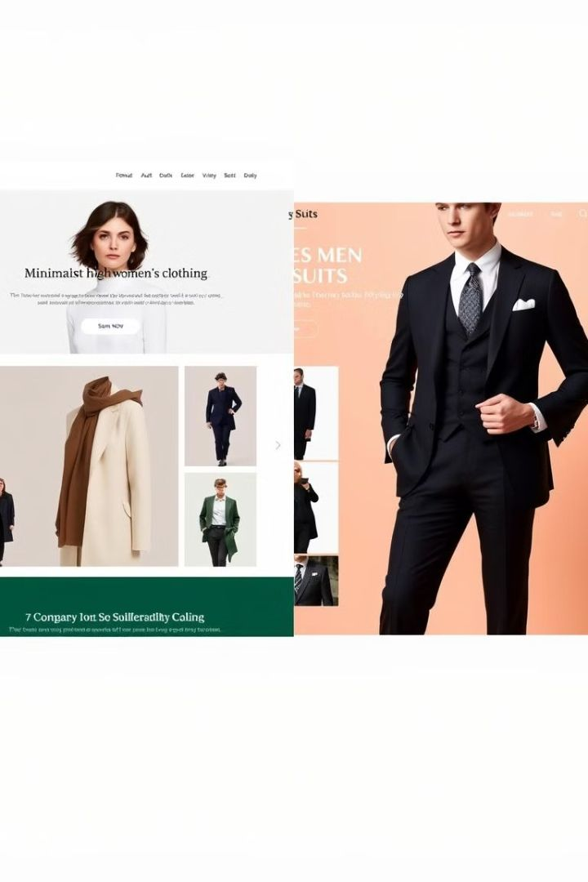
Product Range Comparison
Myntra
Vast selection of clothing, accessories, and beauty products, including domestic and international brands.
Flipkart
Wide fashion segment with a mix of premium and affordable brands for mass appeal.
Amazon
Extensive range leveraging a global marketplace but less curated for
fashion-specific needs.
AJIO
Focused and curated collections, emphasizing unique and indie brands.
Insight: Myntra offers a broader range than AJIO but faces tough competition
from Amazon and Flipkart, which provide diverse categories alongside fashion.

Slide 32
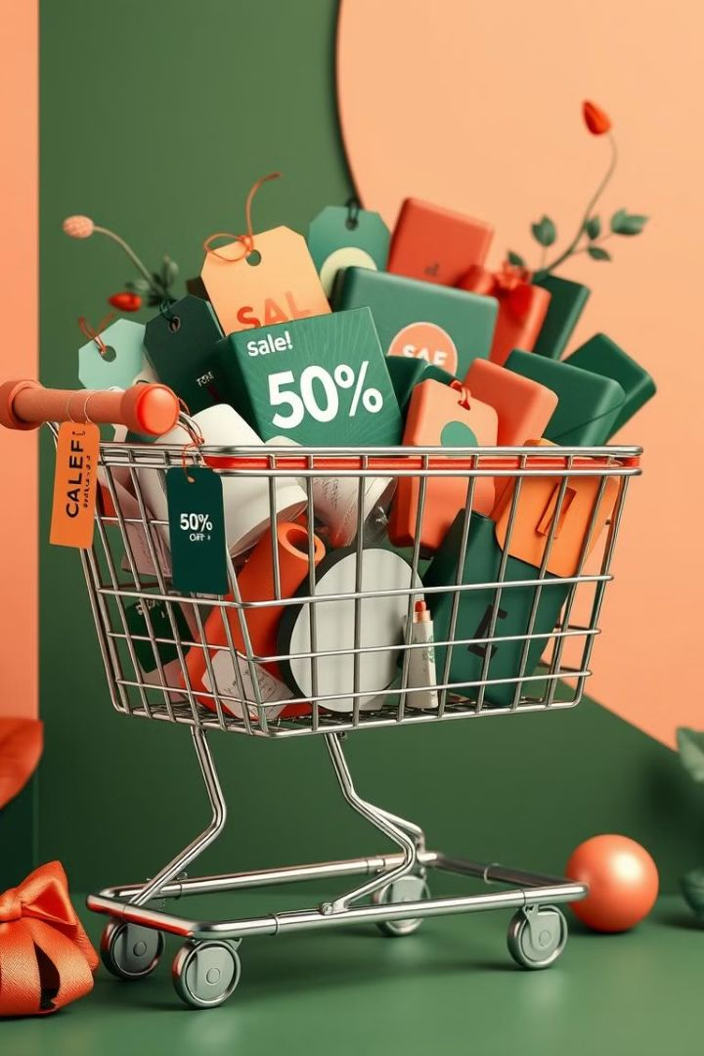
Pricing and Discounts Strategy
1
Myntra
Competitive pricing with frequent sales and discounts.
2
Amazon Fashion
Offers pricing across a wide spectrum with consistent deals.
3
Flipkart
Aggressive pricing strategies during large-scale sales events.
4
AJIO
Competitive pricing with a focus on affordability in its private labels.
Insight: While Myntra's pricing strategy attracts price-sensitive customers, AJIO and Flipkart's competitive pricing challenge Myntra's advantage during sale seasons.

Slide 33
Customer Satisfaction Comparison
Myntra
Amazon Fashion
Praised for its user-friendly interface, reliable delivery, and efficient customer support.
Strong infrastructure ensures high satisfaction, though less fashion-specific attention.
Flipkart
AJIO
Reliable service, though its broad focus may dilute fashion-specific customer attention.
Appreciated for unique collections, but delivery and return processes are still maturing.
Insight: Myntra excels in fashion-specific customer satisfaction, but AJIO is gaining ground with its curated offerings, making it a growing competitor.

Slide 34
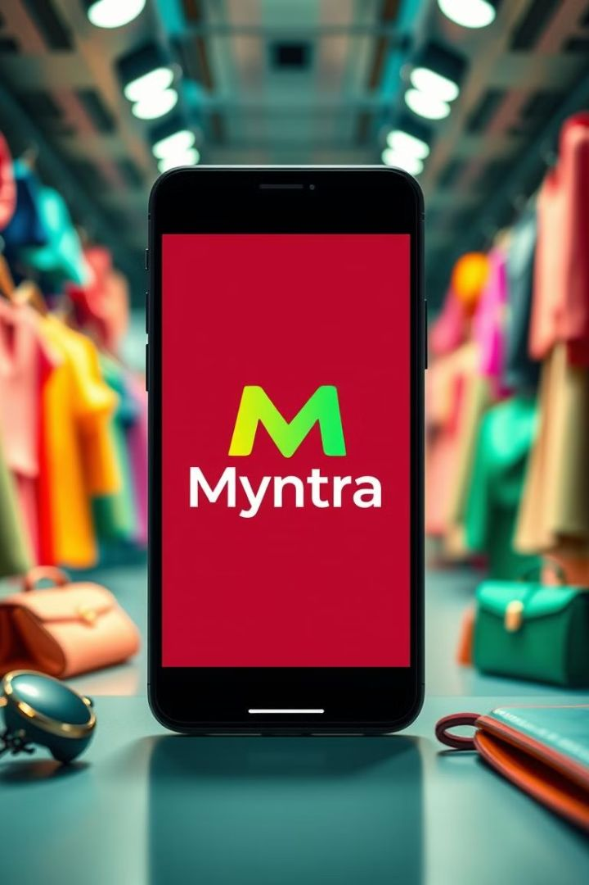
Social Media Presence
Myntra
1
Active and trend-driven campaigns, leveraging influencers and engaging content.
2
Amazon Fashion
Broad promotion but not focused solely on fashion.
3
Flipkart
Targets diverse product categories, with limited focus on fashion-specific campaigns.
4
AJIO
Fashion-focused campaigns that attract a niche, trend-conscious audience.
Insight: Myntra leads in social media engagement for fashion-specific audiences, but AJIO’s targeted strategies for fashion enthusiasts provide healthy competition.

Slide 35
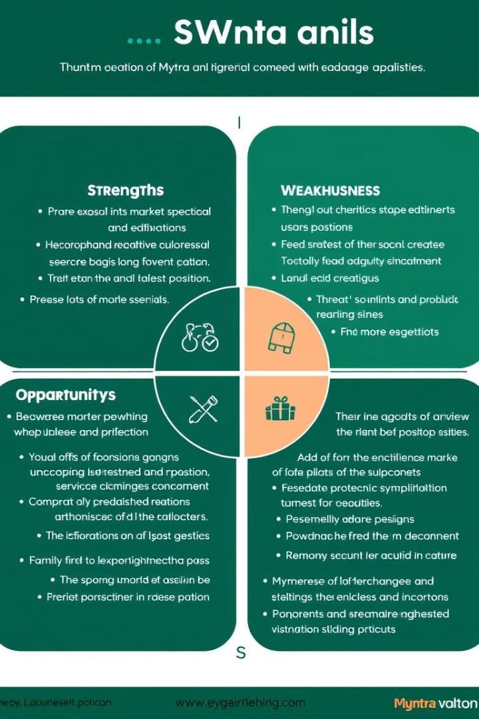
Myntra's Competitive Advantage
1
Specialized Focus
As a fashion-centric platform, Myntra offers a tailored shopping experience with a wide array of brands and styles.
2
User Experience
Provides an intuitive interface and personalized recommendations,
enhancing customer engagement.
3
Exclusive Collaborations
Partners with designers and celebrities for exclusive collections, differentiating its offerings.

Slide 36
Faces intense competition from established players like Amazon Fashion and emerging platforms like AJIO.
Myntra’s Disadvantages
1
High Competition
Faces intense competition from established players like Amazon Fashion and emerging platforms like AJIO.
2
Dependence on Discounts
Frequent reliance on sales and discounts may impact profit
margins and brand perception
Source : RANKEX DIGITAL

Slide 37
TASK-VII
STRATEGIC RECOMMENDATIONS

Slide 38
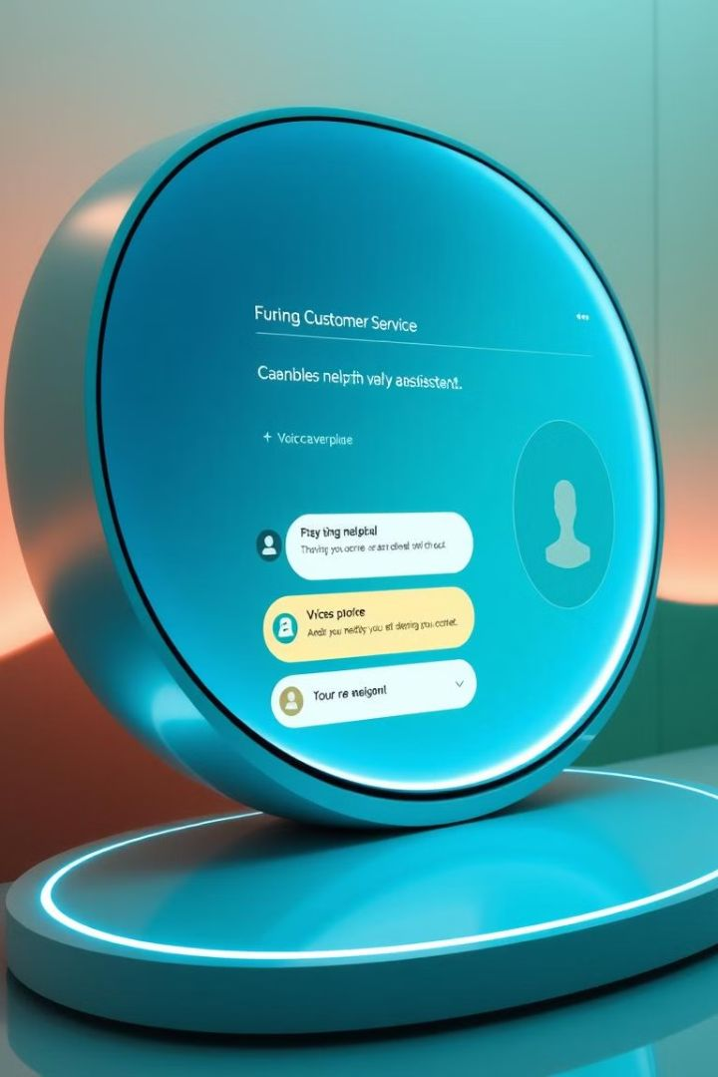
Enhancing Customer Experience
AI-Powered Support
AI-driven chatbots and faster query resolution.
Priority Support
Dedicated line for loyal customers and high-volume shoppers.
Improved Tracking
Enhance real-time tracking features on the app.
Regional Partnerships
Partner with regional delivery services for faster remote area deliveries.

Slide 39
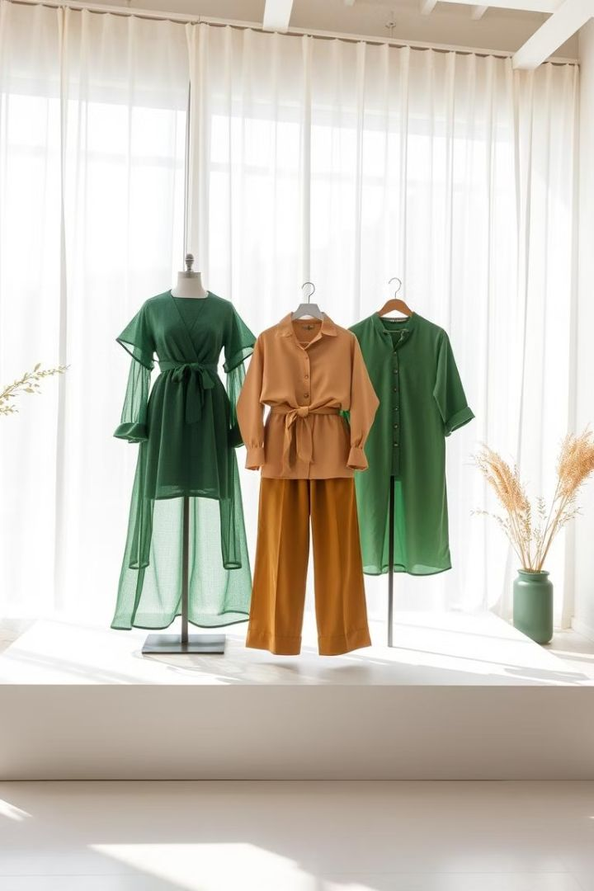


Product Offerings and Expansion
Sustainability
Expand "Myntra For Earth" line with eco-friendly products.
Exclusive Collaborations
Introduce new partnerships with emerging and established brands.
Customer-Driven Collections
Use social media insights to create tailored collections. Add maternity wear,
plus-size, and adaptive clothing.

Slide 40
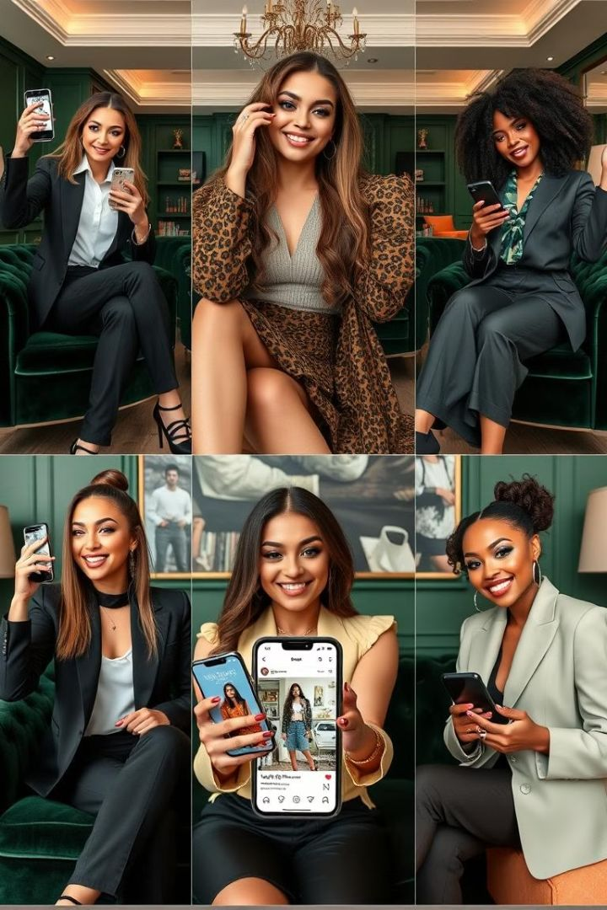
Marketing and Engagement Strategies
Influencer Partnerships
Collaborate with fashion icons to drive engagement and sales.
Social Media Campaigns
Develop campaigns around major sales events and style trends.
Personalized Marketing
Use AI for tailored product recommendations and email campaigns.

Slide 41
Innovation and Sustainability
AR Shopping
Virtual try-on features for a better experience.
Eco-Friendly Initiatives
Sustainable packaging and shipping.
Data-Driven Decisions
Predict trends and optimize inventory.

Slide 42

Implementation Roadmap
1
Short-Term (0-6 months)
Improve customer service and launch influencer campaigns.
2
Medium-Term (6-18 months)
Expand sustainable products and increase personalized marketing efforts.
3
Long-Term (18-24 months)
Establish leadership in sustainable fashion e-commerce and invest in AI technologies.

Slide 43
RESULTS AND CONCLUSION

Slide 44

Key Insights and Takeaways
1. Enhance service quality with AI-driven support and
proactive issue resolution.
4. Leverage influencers and trend-driven content for
broader engagement.
2. Launch loyalty programs to retain and reward frequent
shoppers.
5. Personalize campaigns to target varied demographics
and regional audiences.
3. Diversify into adaptive, sustainable, and regional fashion
categories.
6. Promote eco-friendly collections and adopt
sustainable practices in logistics and packaging.

Slide 45

Conclusion
1
Strategic Actions
2
Align with Trends
3
Long-Term Growth
Implement recommendations to solidify market position and enhance customer loyalty.
Focus on customer experience and current fashion trends.
Secure Myntra's leadership in India's online fashion market.

